Slide 1

6th Grade Accelerated Math
Unit 14, Lesson 10
Solving One-Step Inequalities Using Multiplication and Division Volume 2, pg. 391

Slide 2


Benchmark
MA.7.AR.2.1
Write and solve one-step inequalities in one variable within a mathematical context and represent solutions algebraically or graphically.
volume 2, pg. 391

Slide 3
Integrated Mathematical Thinking and Reasoning Standards
MA.K12.MTR.1.1 Actively participate in effortful learning both individually and collectively.
MA.K12.MTR.2.1 Demonstrate understanding by representing problems in multiple ways.
MA.K12.MTR.4.1 Engage in discussions that reflect on the mathematical thinking of self and others.
MA.K12.MTR.5.1 Use patterns and structure to help understand and connect mathematical concepts.
MA.K12.MTR.6.1 Assess the reasonableness of solutions.
MA.K12.MTR.7.1 Apply mathematics to real-world contexts.
volume 2, pg. 391

Slide 4

Learning Targets
I can determine the minimum or maximum value that makes an inequality true.
I can explore the relationship between the coefficients of the terms in an inequality and solution set.
I can solve one-step inequalities in one variable using multiplication or division.
I can relate properties of inequality to solving one-step inequalities algebraically.
volume 2, pg. 391

Slide 5

Warm-Up
volume 2, pg. 391

Slide 6
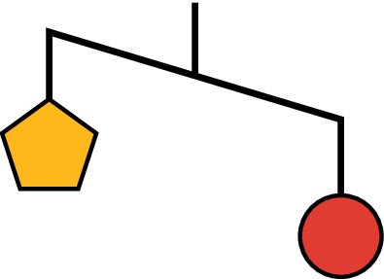
14.10.1 Warm-Up: Visual Model
An unbalanced hanger diagram is shown.
It shows that the weight of one circle is greater than the weight of one pentagon.
volume 2, pg. 391

Slide 7
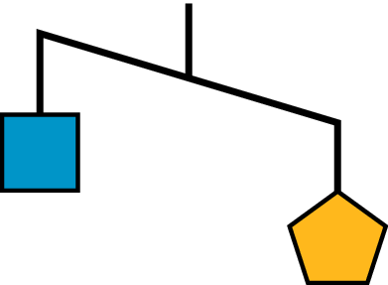
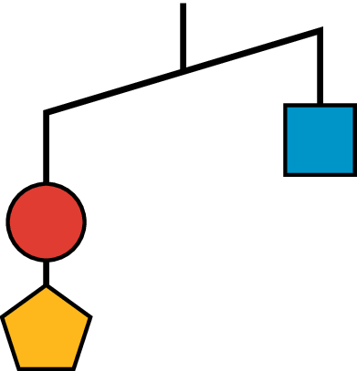
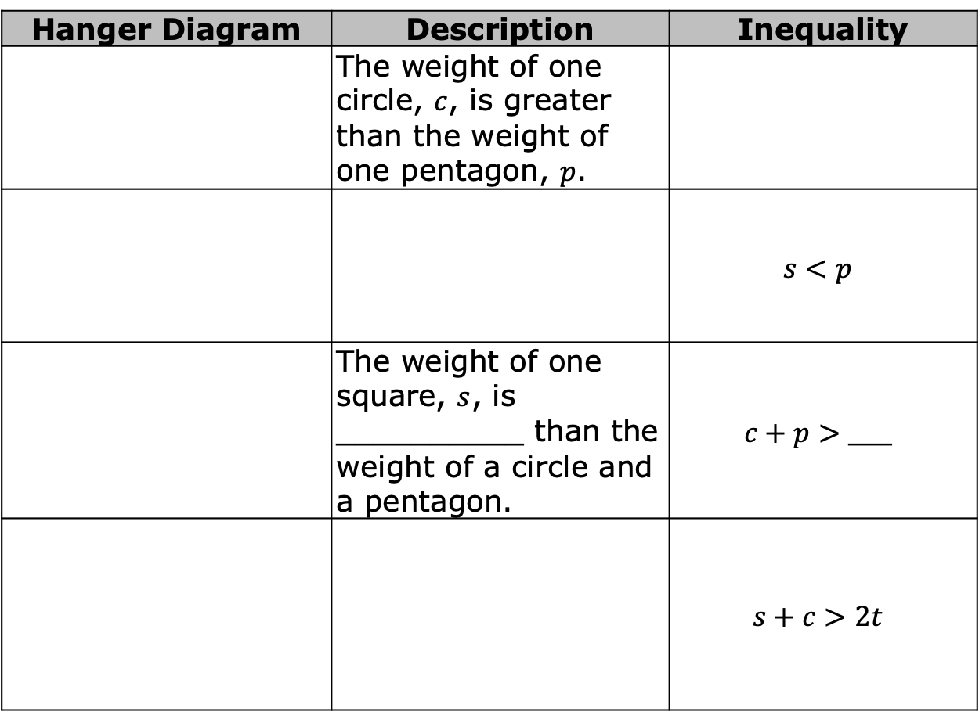
Complete the table.
Hanger Diagram | Description | Inequality
 | The weight of one circle, $c$, is greater than the weight of one pentagon, $p$.
 |  | $$s<p$$
 | The weight of one square, $s$, is __________ than the weight of a circle and a pentagon. | $$c+p>____$$
 |  | $$s+c>2t$$
volume 2, pg. 391

Slide 8

Exploration
volume 2, pg. 392

Slide 9

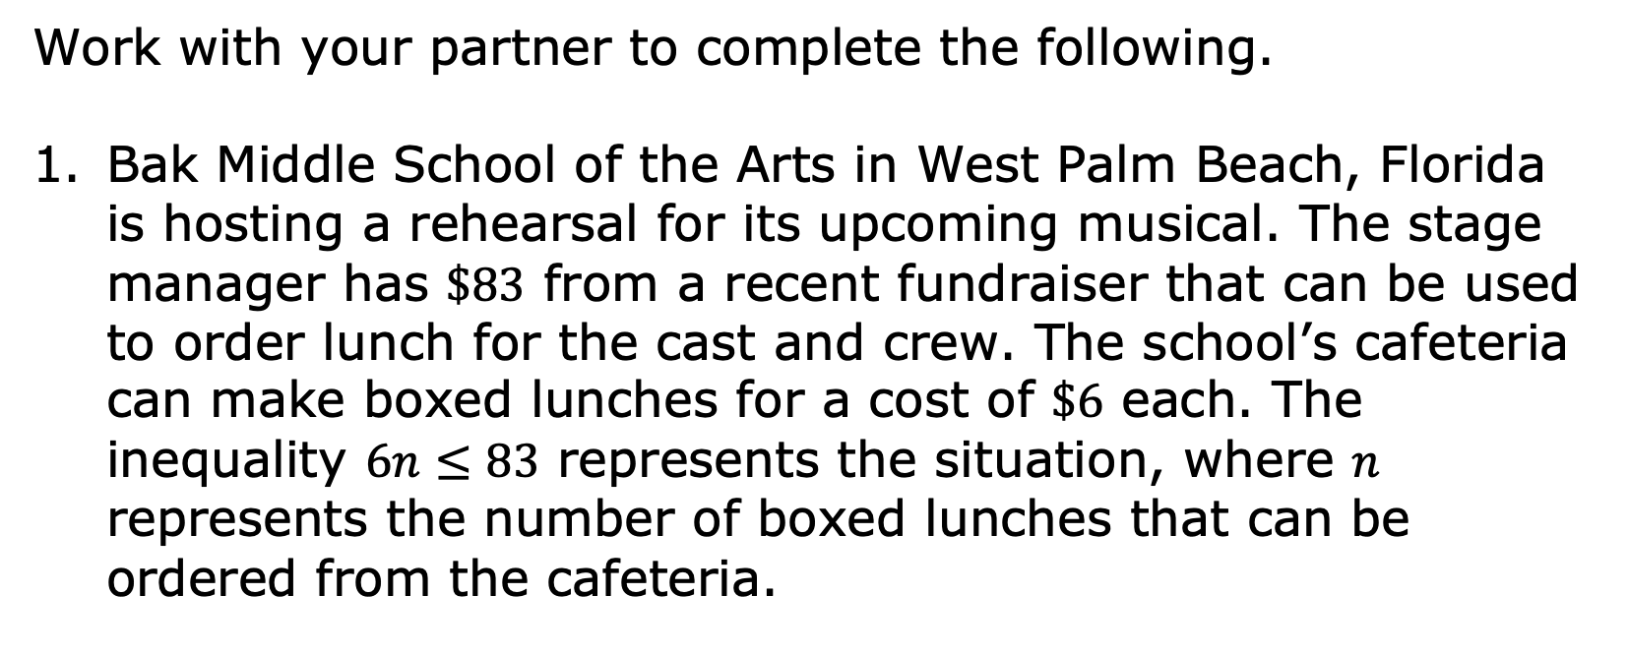
14.10.2 Exploration: Determining the Minimum or Maximum Value that Makes an Inequality True
Work with your partner to complete the following.
Bak Middle School of the Arts in West Palm Beach, Florida is hosting a rehearsal for its upcoming musical. The stage manager has $\$83$ from a recent fundraiser that can be used to order lunch for the cast and crew. The school’s cafeteria can make boxed lunches for a cost of $\$6$ each. The inequality $6n≤83$ represents the situation, where $n$ represents the number of boxed lunches that can be ordered from the cafeteria.
volume 2, pg. 392

Slide 10
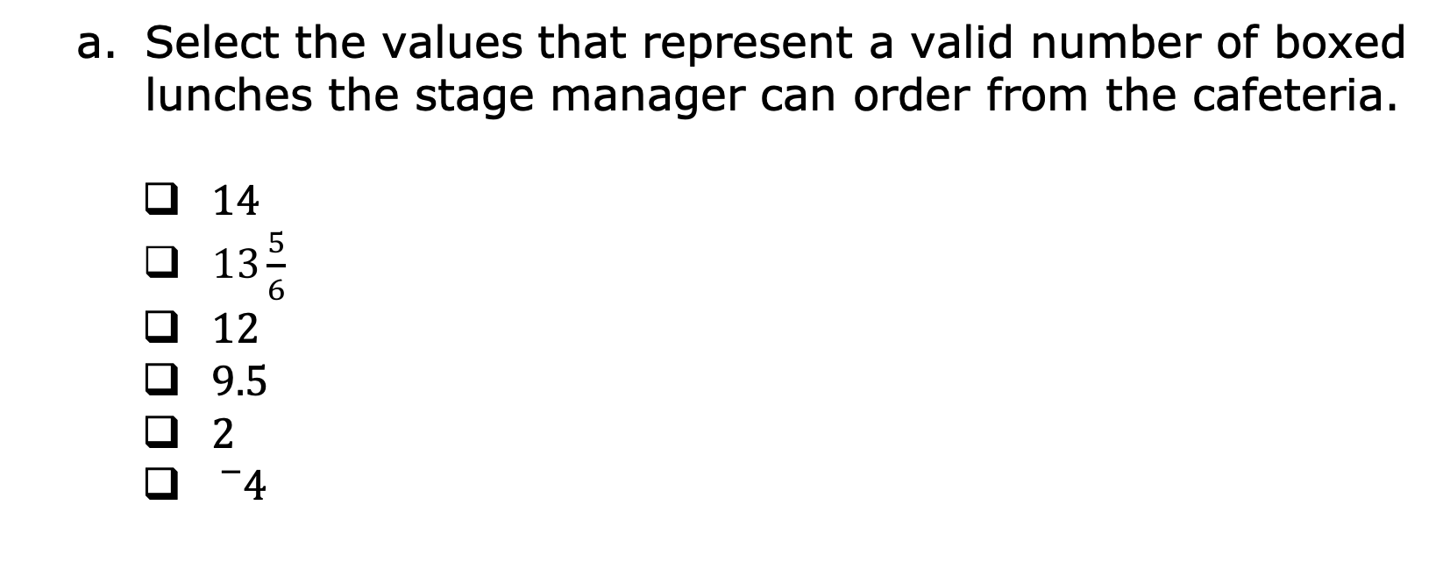
Select the values that represent a valid number of boxed lunches the stage manager can order from the cafeteria.
$14$
$13\frac{5}{6}$
$12$
$9.5$
$2$
${}_{}^{−}4$
volume 2, pg. 392

Slide 11
Explain why some values in the previous question are not valid in this context.
volume 2, pg. 392

Slide 12
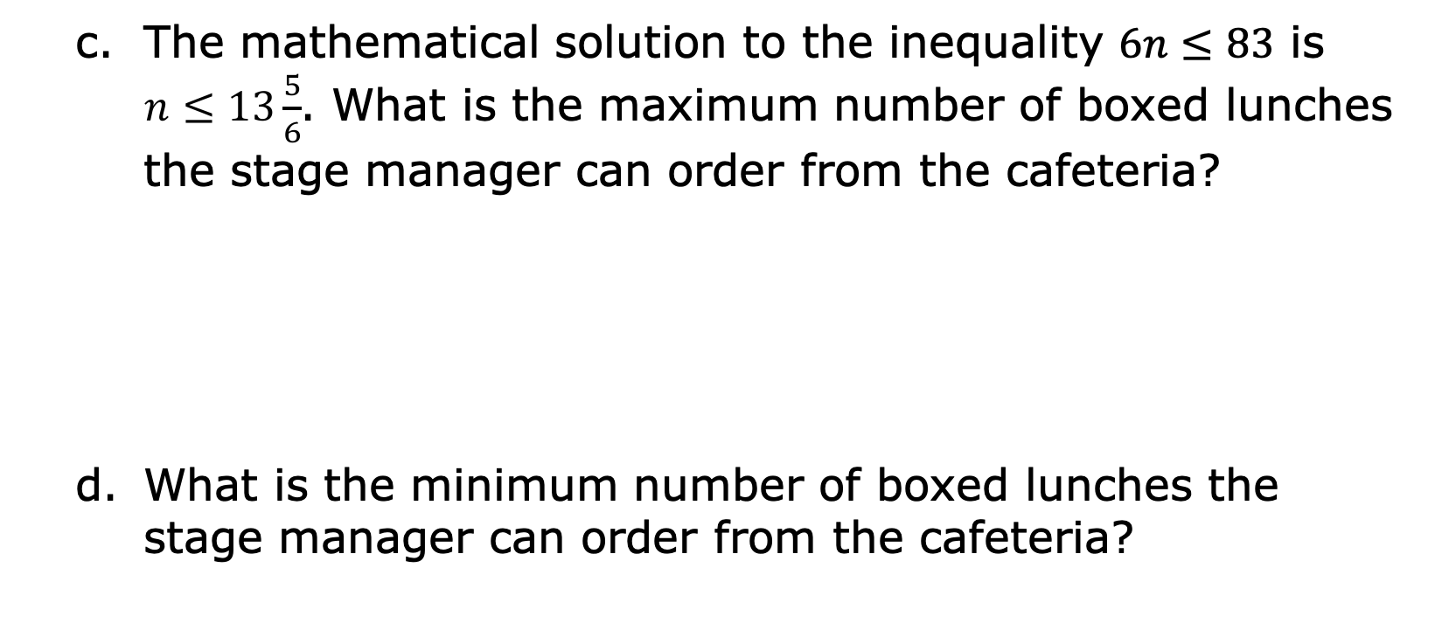
The mathematical solution to the inequality $6n≤83$ is $n≤13\frac{5}{6}$. What is the maximum number of boxed lunches the stage manager can order from the cafeteria?
What is the minimum number of boxed lunches the stage manager can order from the cafeteria?
volume 2, pg. 392

Slide 13
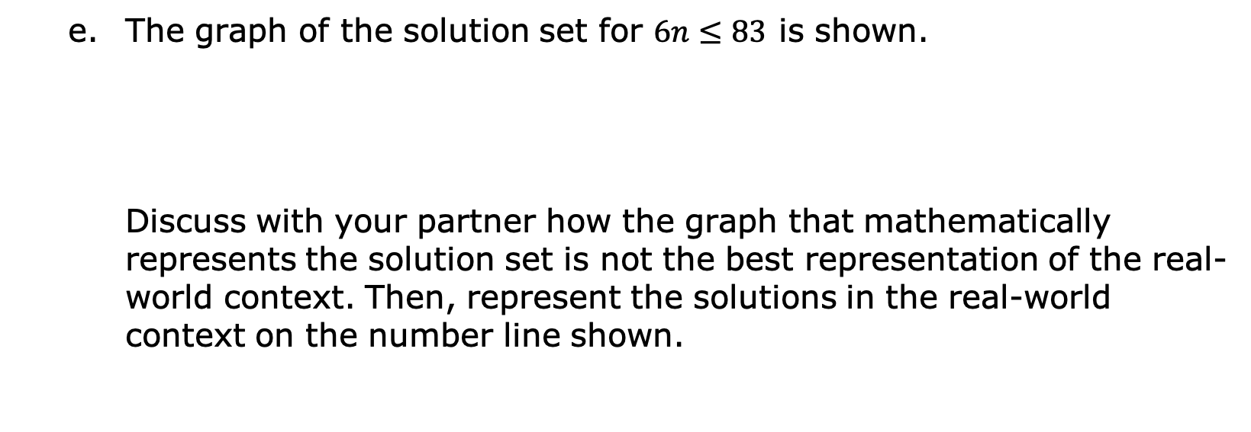
The graph of the solution set for $6n≤83$ is shown.
Discuss with your partner how the graph that mathematically represents the solution set is not the best representation of the real-world context. Then, represent the solutions in the real-world context on the number line shown.
volume 2, pg. 393

Slide 14
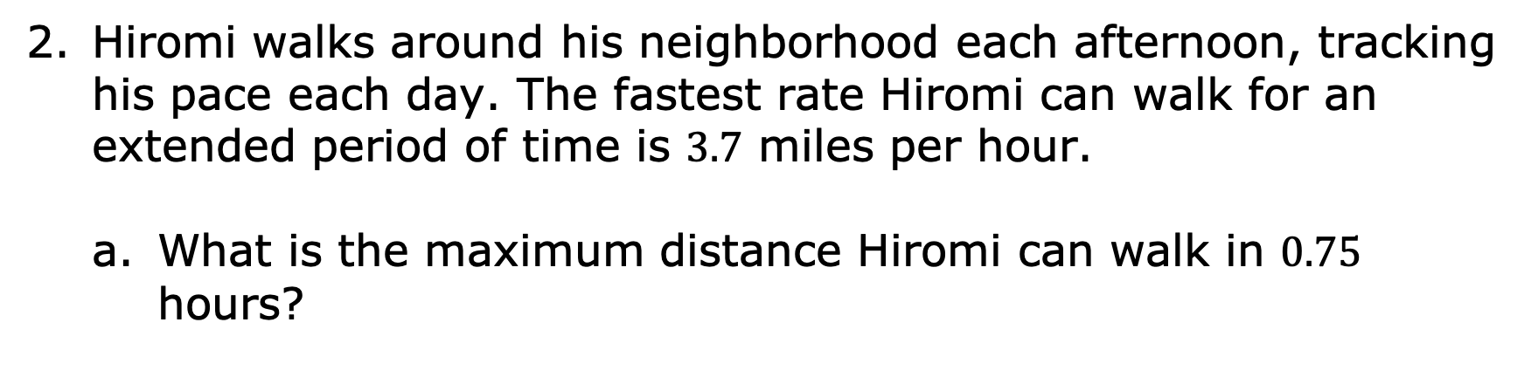
Hiromi walks around his neighborhood each afternoon, tracking his pace each day. The fastest rate Hiromi can walk for an extended period of time is $3.7$ miles per hour.
What is the maximum distance Hiromi can walk in $0.75$ hours?
volume 2, pg. 393

Slide 15
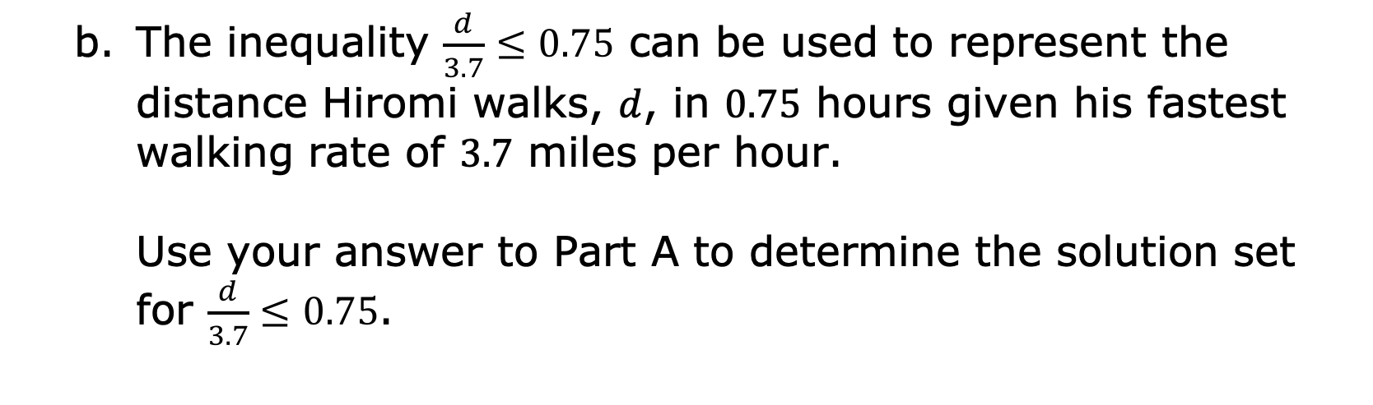
The inequality $\frac{d}{3.7}≤0.75$ can be used to represent the distance Hiromi walks, $d$, in $0.75$ hours given his fastest walking rate of $3.7$ miles per hour.
Use your answer to Part A to determine the solution set for $\frac{d}{3.7}≤0.75$.
volume 2, pg. 393

Slide 16

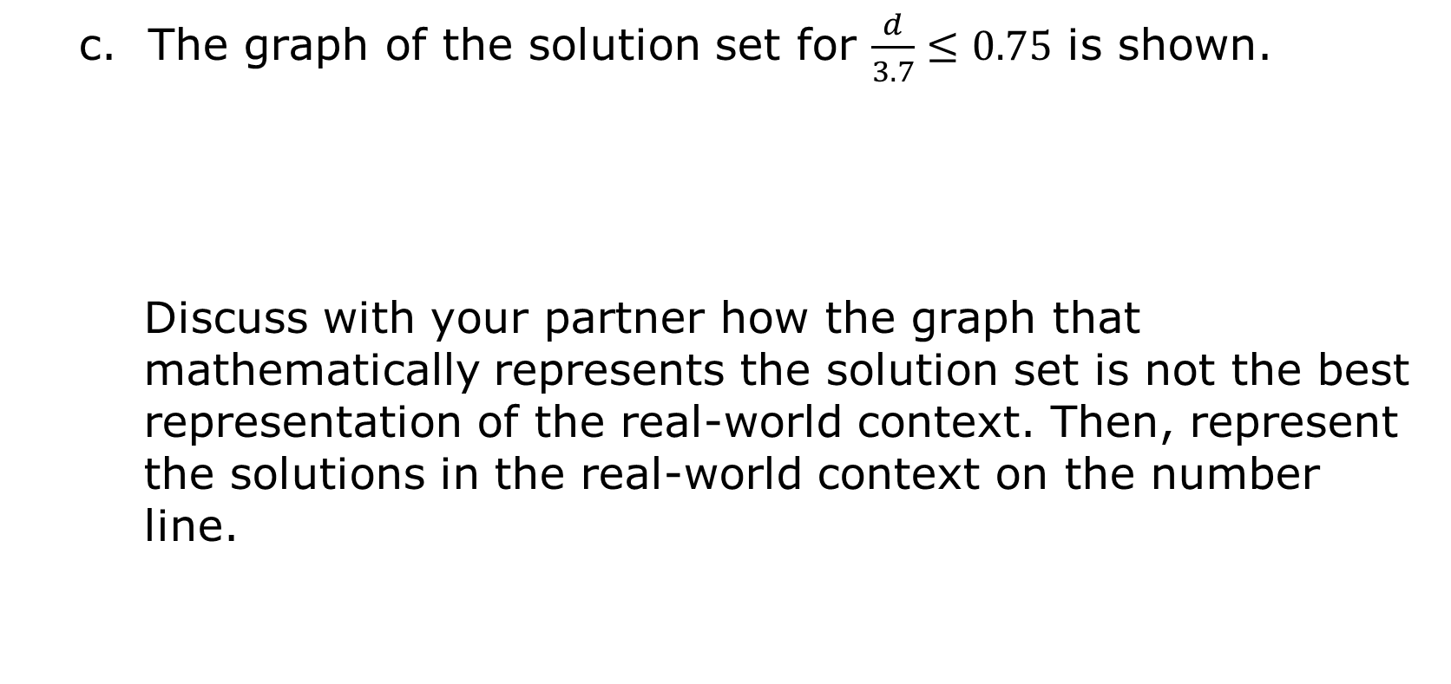
c. The graph of the solution set for $\frac{d}{3.7}≤0.75$ is shown.
Discuss with your partner how the graph that mathematically represents the solution set is not the best representation of the real-world context. Then, represent the solutions in the real-world context on the number line.
volume 2, pg. 393

Slide 17

Bring It Together
volume 2, pg. 394

Slide 18


14.10.3 Bring It Together: Solutions and Mathematical Models in Context
Each of the inequalities in the Exploration has a mathematical solution set that can be represented on a number line. These graphs are examples of mathematical models.
Mathematical models are helpful tools used to understand a situation and make predictions. However, sometimes the mathematical model can include parts that do not make sense in a real-world context. When interpreting models to solve problems, it is important to analyze whether aspects of the model make sense in a given context.
volume 2, pg. 394

Slide 19

Collaboration
volume 2, pg. 394

Slide 20

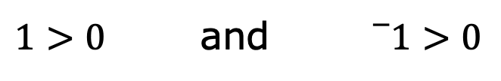
14.10.4 Collaboration: The Effect of a Negative Coefficient
Two simple inequalities are shown.
Circle the inequality that is true and cross out the inequality that is false.
$1>0$ and ${}_{}^{−}1>0$
volume 2, pg. 394

Slide 21
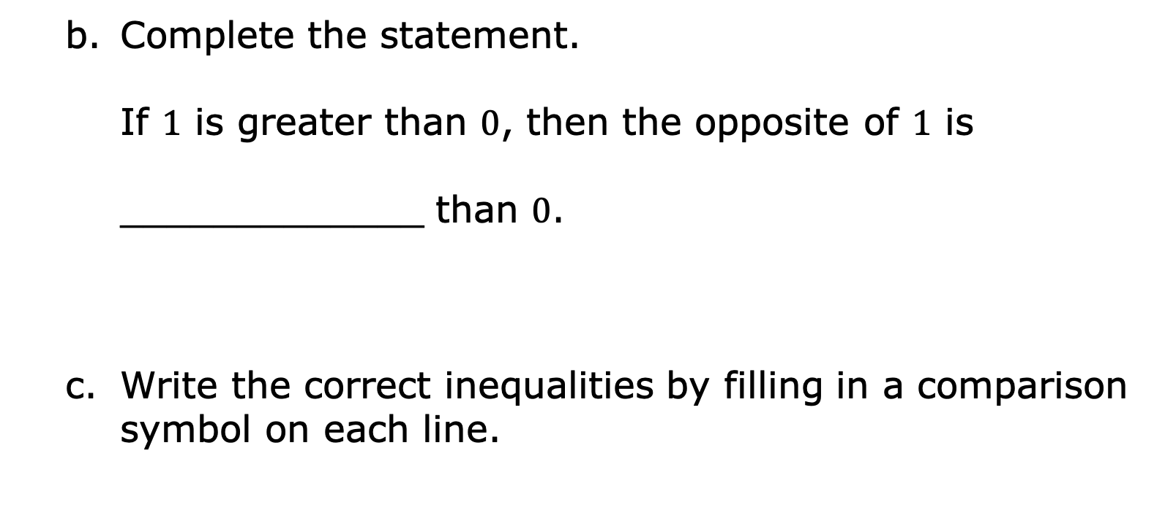
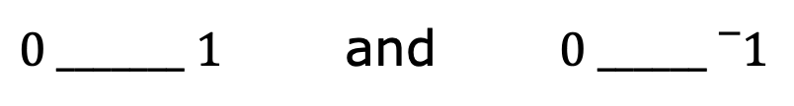
Complete the statement.
If $1$ is greater than $0$, then the opposite of $1$ is
_____________ than $0$.
Write the correct inequalities by filling in a comparison symbol on each line.
$0 _______ 1$ and $0 ______{}_{}^{−}1$
volume 2, pg. 394

Slide 22
Verify your answers with your partner on parts A-C and, if necessary, resolve any differences.
volume 2, pg. 394

Slide 23
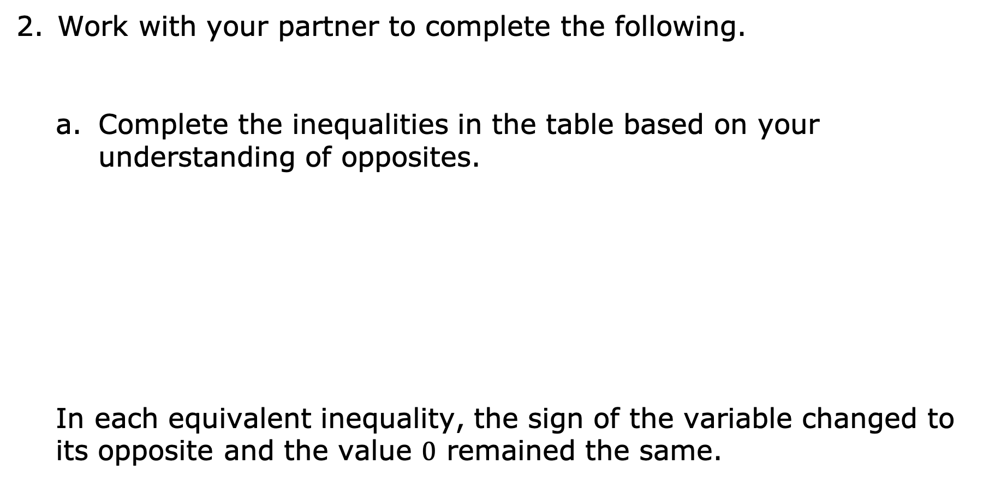
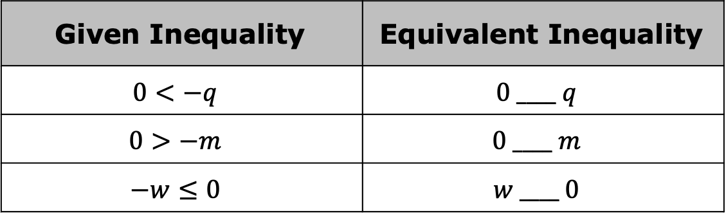
Work with your partner to complete the following.
Complete the inequalities in the table based on your understanding of opposites.
In each equivalent inequality, the sign of the variable changed to its opposite and the value $0$ remained the same.
Given Inequality | Equivalent Inequality
$$0<−q$$ | $$0 ____ q$$
$$0>−m$$ | $$0 ____ m$$
$$−w≤0$$ | $$w ____ 0$$
volume 2, pg. 395

Slide 24
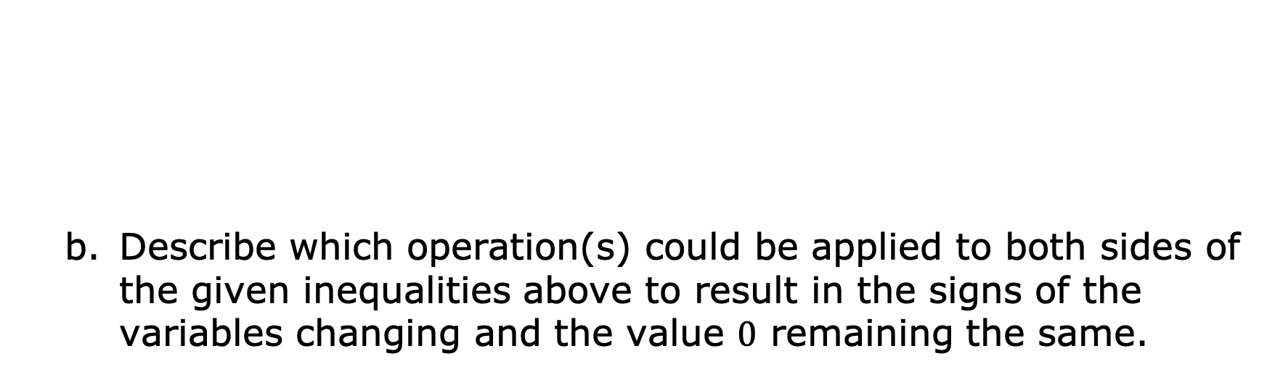
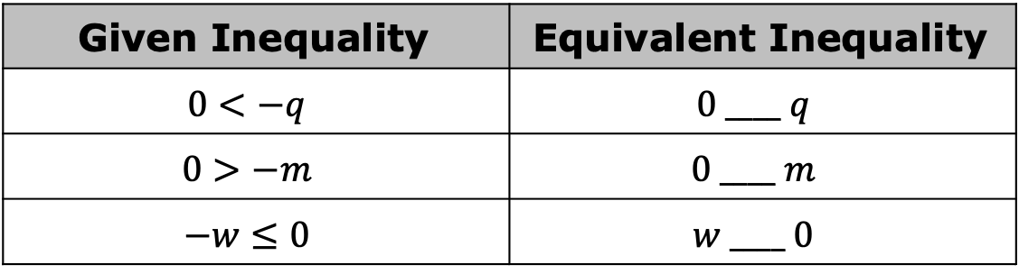
Given Inequality | Equivalent Inequality
$$0<−q$$ | $$0 ____ q$$
$$0>−m$$ | $$0 ____ m$$
$$−w≤0$$ | $$w ____ 0$$
Describe which operation(s) could be applied to both sides of the given inequalities above to result in the signs of the variables changing and the value $0$ remaining the same.
volume 2, pg. 395

Slide 25
Given Inequality | Equivalent Inequality
$$0<−q$$ | $$0 ____ q$$
$$0>−m$$ | $$0 ____ m$$
$$−w≤0$$ | $$w ____ 0$$
Describe what happens to the comparison symbol in the inequality when either of these operations are applied.
volume 2, pg. 395

Slide 26
Bring It Together
volume 2, pg. 395

Slide 27
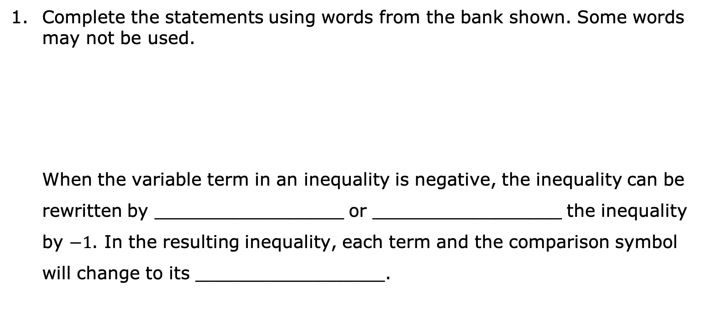
14.10.5 Bring It Together: The Effect of a Negative Coefficient
Complete the statements using words from the bank shown. Some words may not be used.
When the variable term in an inequality is negative, the inequality can be rewritten by _________________ or _________________ the inequality by $−1$. In the resulting inequality, each term and the comparison symbol will change to its _________________.
adding subtracting multiplying dividing opposite
volume 2, pg. 395

Slide 28

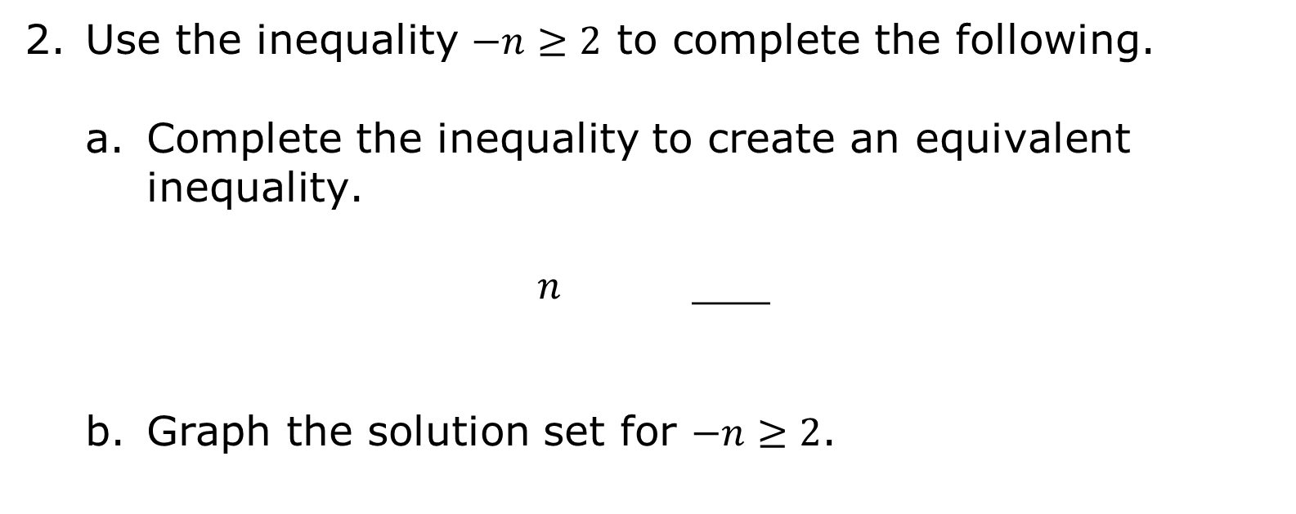
Use the inequality $−n≥2$ to complete the following.
Complete the inequality to create an equivalent inequality.
$n$ ___
Graph the solution set for $−n≥2$.
volume 2, pg. 395

Slide 29

Guided Instruction
volume 2, pg. 396

Slide 30
14.10.6 Guided Instruction: Solving One-Step Inequalities with Multiplication and Division
As with solving one-step inequalities with addition and subtraction, properties of inequality can be used to solve inequalities with multiplication and division. As discovered in the Collaboration, though, when the value that is being multiplied or divided is negative, this changes both the values in the inequality and the comparison symbol to their opposites.
volume 2, pg. 396

Slide 31

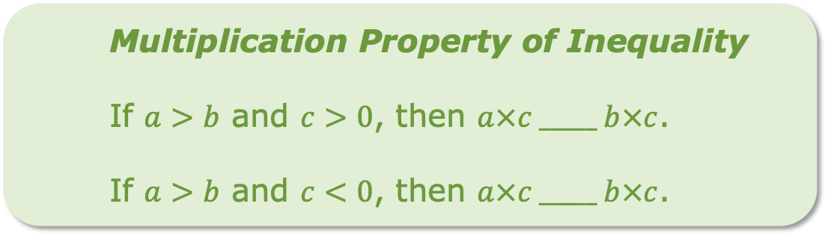
Multiplying both sides of an inequality by the same value can be used to solve an inequality by the multiplication property of inequality.
Multiplication Property of Inequality
If $a>b$ and $c>0$, then $a×c _____ b×c$.
If $a>b$ and $c<0$, then $a×c _____ b×c$.
volume 2, pg. 396

Slide 32
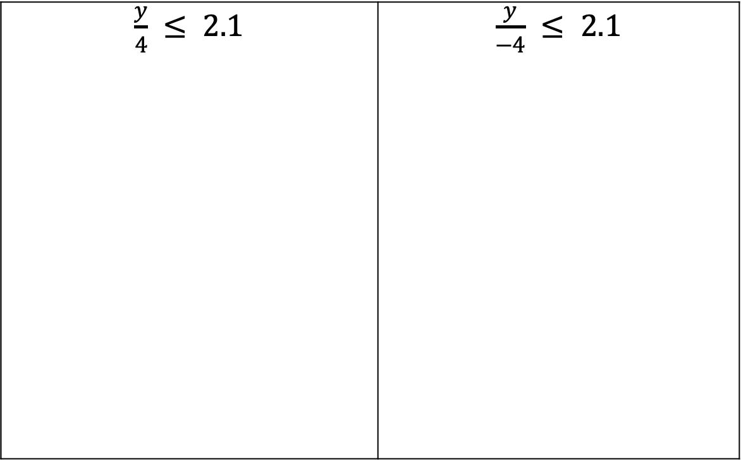
Find the solution to both inequalities using the multiplication property of inequality.
$\frac{y}{4} ≤ 2.1$ | $\frac{y}{−4} ≤ 2.1$
volume 2, pg. 396

Slide 33
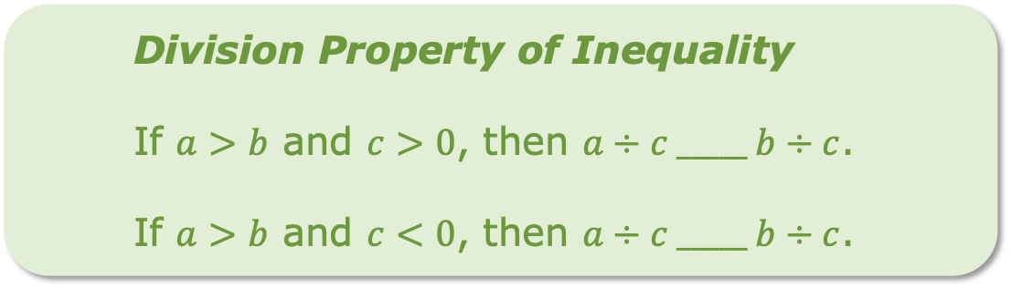
Dividing both sides of an inequality by the same value can be used to solve an inequality by the division property of inequality.
Division Property of Inequality
If $a>b$ and $c>0$, then $a÷c _____ b÷c$.
If $a>b$ and $c<0$, then $a÷c _____ b÷c$.
volume 2, pg. 396

Slide 34
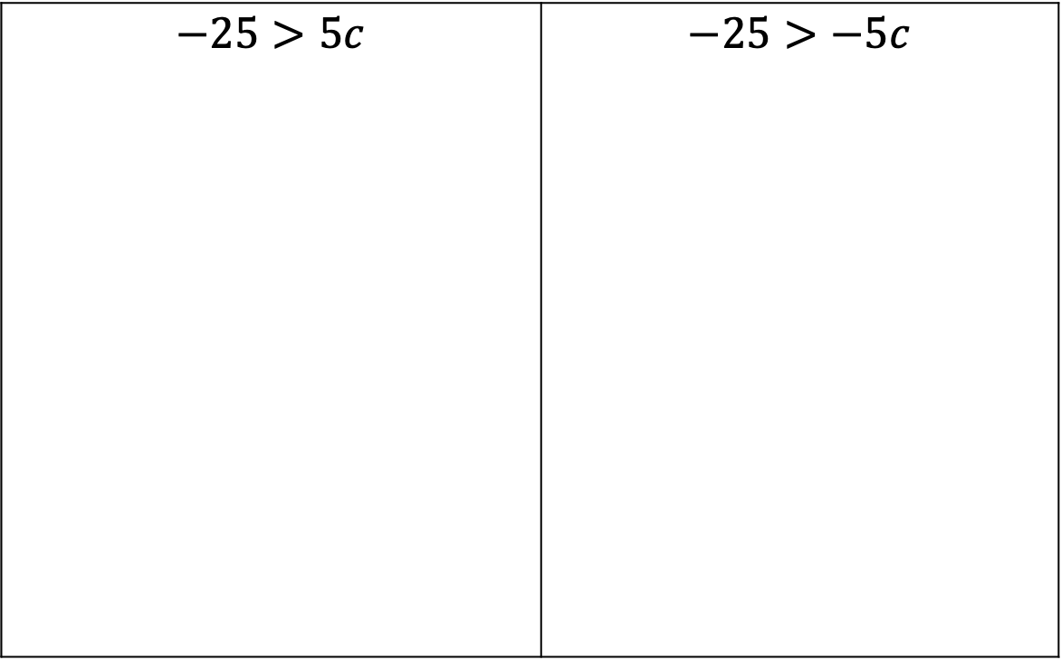
Find the solution to both inequalities using the division property of inequality.
$−25>5c$ | $−25>−5c$
volume 2, pg. 396

Slide 35

Wrap-Up
volume 2, pg. 397

Slide 36

14.10.7 Wrap-Up: Cool Down
Two inequalities are shown.
$2.5x≥−10$ $−2.5x≥−10$
volume 2, pg. 397

Slide 37
Complete the table to describe how the process of solving each inequality is similar and different.
How is the process of solving each inequality similar? | How is the process of solving each inequality different?
volume 2, pg. 397

